Slide 1
NBA Draft Analysis: Data-Driven Decision-Making for Smarter Draft Picks
BY: Sherod Brooks

Slide 2
Executive Summary
Evaluate past and present NBA player stats to identify patterns that predict long-term success.
Uncover insights that help teams not only find top prospects but also hidden gems.
Build a data-driven framework for smarter, more informed draft decisions.

Slide 3
Methodology overview
Analysis Flow:
Tools Used:
- Cleaned and structured raw data (Excel & SQL)
- Performed EDA & feature classification (Python)
- Applied Z-score modeling to identify performance tiers
- Focused on statistical patterns tied to position, pick range, and college performance
- Visualized findings (Power BI)
- Excel
- SQL
- Python (Pandas)
- Power BI

Slide 4
Excel Data Cleaning
1. Pulled raw NBA player data from Kaggle
2. Formatted the dataset to make it analysis-ready
3. Handled missing values to ensure clean, reliable insights
4. Created new columns to support later analysis and modeling
5. Applied early filtering to focus on relevant player stats and draft years

Slide 5
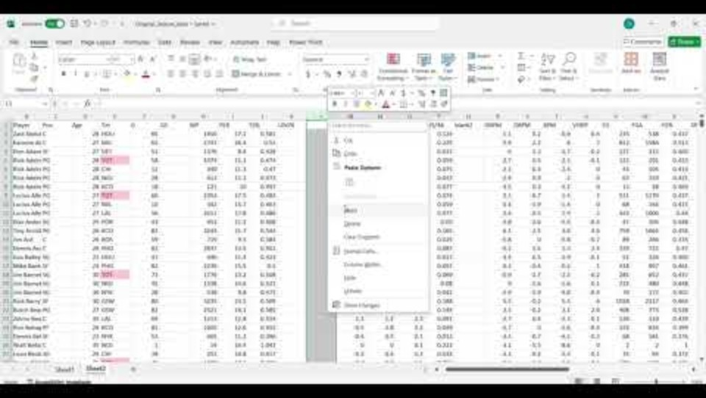
Excel Data Cleaning Video

Slide 6
SQL
Imported raw data straight from Excel to get started
Cleaned up and updated column values to make everything consistent
Joined player info with performance stats to build one complete dataset
Formatted and organized the table so it was ready for analysis later on

Slide 7
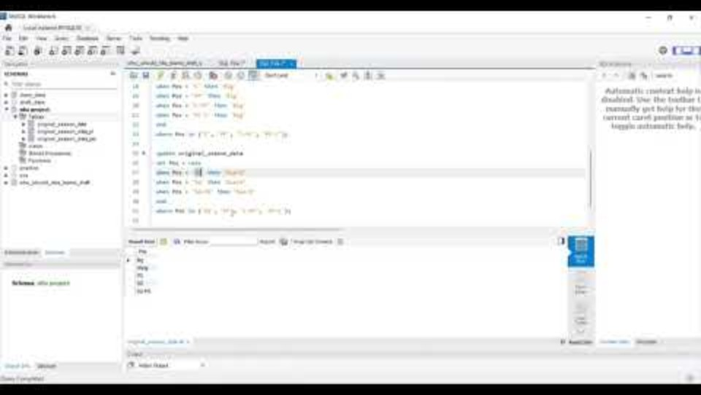
SQL Video

Slide 8
Python(Pandas) Data Analysis
Started by reading in the player data from Excel
Cleaned things up by removing duplicates and filling in missing values
Compared player performance by position and where they were drafted to spot early patterns
Used Z-scores to highlight standout players and identify those who really underperformed
Created performance categories to clearly show overperformers, underperformers, and average players
Took it further by labeling players as stars or busts based on how far their stats deviated from expectations
Looked at how draft position correlated with advanced metrics like PER and Win Shares
Finally, used clustering to group similar players together and uncover hidden trends in play style and production

Slide 9
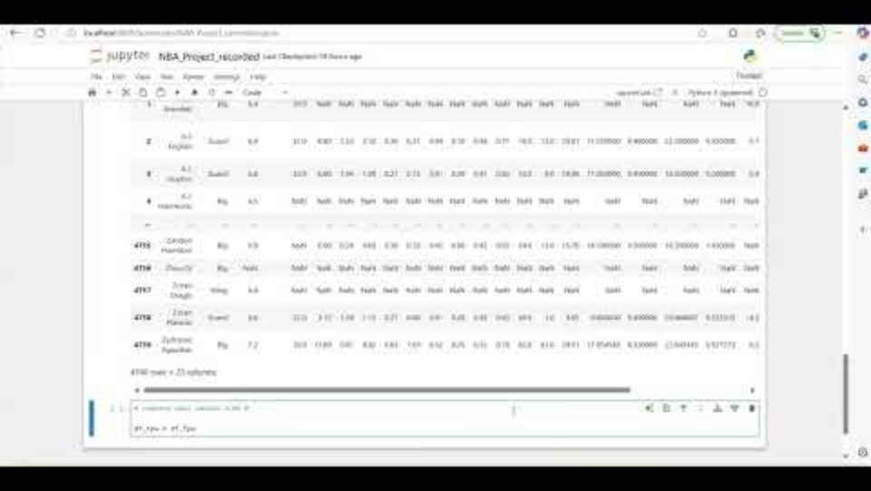
Python(Pandas) Data Analysis Video

Slide 10
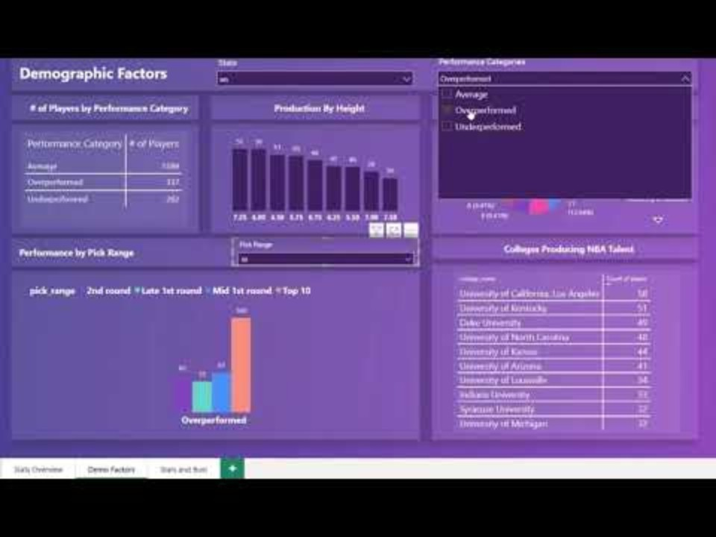
Power BI Dashboard

Slide 11
Recommendations
Look beyond the lottery
Some of the league’s biggest stars were drafted late. Use data to find undervalued prospects in later rounds. And what those players had in common with one another.
1
Use standardized metrics
Z-scores help compare players across different eras, positions, and draft classes objectively.
2
Prioritize role-specific strengths
Instead of one-size-fits-all scouting, evaluate players based on what matters most for their position (e.g., guards, wings, bigs).
3
Incorporate historical performance trends
Analyze what’s worked before: which college programs consistently produce high-impact players.
4
Build data-backed scouting models
Use clustering and classification to guide scouting efforts and flag potential overperformers early.
5

Slide 12
Next Steps
Deepen advanced metrics analysis - Having used metrics like PER, TS%, USG, and WS. Next digging into Offensive/Defensive Ratings, Box Plus/Minus, VORP, and on/off-court impact to capture true player value.
Develop predictive models - Use supervised learning (e.g., logistic regression, random forest) to predict draft outcomes based on college and pre-draft metrics.
Expand dataset scope - Bring in G-League, international leagues, and Summer League data to capture overlooked talent pools and alternative player paths.
Track progression over time - Analyze how players evolve for example: rookie year vs. year 3 or 5, to evaluate draft success and model long-term potential.
Enhance scouting perspective - Blend in qualitative scouting reports or combine stats with physical attributes (e.g., wingspan, athletic testing) for a hybrid analysis.

Slide 13
Conclusion
This project set out to identify patterns in NBA draft data that correlate with long-term player success, and the analysis delivered meaningful insights toward that goal.
By exploring historical stats, draft positions, and advanced metrics, I uncovered trends that help explain which players exceed or fall short of expectations.
Tools like Z-score classification, clustering, and role-based comparisons helped surface not only top-tier talent, but also undervalued players often missed by traditional scouting.
The result is a data-driven framework that supports smarter, more objective draft decisions—and provides a foundation for future predictive models and scouting tools.

